Slide 1
BOB AND BEYOND · AI TRACK · IBM BOB HACKATHON
Mission Readiness Copilot
AI-powered predictive maintenance and mission-readiness
intelligence for aircraft engines
From sensor data → prediction → readiness → maintenance action — with IBM Bob as the Copilot.
MISSION READINESS COPILOT
01

Slide 2
THE PROBLEM
Engines are grounded on the calendar, not on their actual condition
Military organisations cannot reliably determine whether aircraft engines are truly mission-ready. Maintenance is typically scheduled on fixed calendar intervals rather than actual component condition — while sensor data capable of predicting failures weeks in advance goes largely underused.
Our goal: transform raw aircraft sensor data into actionable mission-readiness intelligence.
$
Unnecessary cost
!
Readiness risk
Healthy engines are pulled in and serviced on schedule, burning maintenance hours and budget on components that didn't need attention.
Engines that are quietly degrading can fail unexpectedly — threatening mission readiness right when the fleet is needed most.
MISSION READINESS COPILOT
02

Slide 3
OUR SOLUTION
Mission Readiness Copilot
An AI-powered predictive maintenance platform that analyses aircraft engine sensor data and determines whether each engine is ready for an upcoming mission.
1
2
3
4
Ingest sensor data
Predict RUL
Augment & bound
Classify readiness
Streams engine sensor readings from the NASA C-MAPSS dataset
A six-model ensemble estimates Remaining Useful Life per engine
Test-time augmentation plus confidence intervals around each prediction
Engines are labelled READY / AT_RISK / NOT_READY for the mission window
5
6
7
Flag mission risk
Plan maintenance
Explain the call
Detects engines likely to fail before the configured mission window
Auto-generates a ranked, prioritised maintenance plan
Attention-based explainability for every individual prediction
MISSION READINESS COPILOT
03

Slide 4
KEY FEATURE 01
Ensemble RUL Prediction
A six-model ensemble predicts each engine's Remaining Useful Life (RUL), refined with test-time augmentation and wrapped in a confidence interval that captures prediction uncertainty.
13.04
RMSE
Root mean square error across all test engines
Six-model ensemble votes on Remaining Useful Life
Test-time augmentation improves prediction robustness
0.90
Confidence intervals quantify prediction uncertainty
R² Score
Proportion of RUL variance explained by the model
MISSION READINESS COPILOT
04

Slide 5
KEY FEATURE 02
Mission-Readiness Classification
RUL predictions are translated into an operational readiness status against a configurable mission window — with fails-before-mission detection to flag critical engines before deployment.
✓
✓
✓
READY
AT_RISK
NOT_READY
Engine has sufficient predicted remaining life for the mission
Engine may complete the mission but has limited remaining margin
Engine is predicted to fail before or within the mission window
MISSION READINESS COPILOT
05

Slide 6
KEY FEATURE 03
Automated Maintenance Planning
The system ranks engines by operational risk and recommends the matching maintenance action — turning predictive analytics into an actionable workflow.
CRITICAL
Immediate Overhaul
Engine is at or near failure risk within the mission window
HIGH
Priority Inspection
Meaningful risk of degradation — needs a closer look soon
MEDIUM
Schedule Inspection
Within normal margins, but worth a routine check-in
MISSION READINESS COPILOT
06

Slide 7
KEY FEATURE 04 – 05
Explainable AI, delivered through IBM Bob
◉
Explainable AI
□
IBM Bob + MCP
Temporal attention-based explainability highlights which portions of an engine's sensor history most influenced its prediction. Every engine also gets a natural-language readiness summary, making outputs easy for maintenance personnel to interpret.
IBM Bob is connected directly to the live predictive-maintenance system via the Model Context Protocol (MCP). Engineers can ask fleet questions in plain language and get answers sourced from the live FastAPI backend — not simulated responses.
“Which engines are not ready for the next mission?”
READINESS SUMMARY (SAMPLE)
“Engine 42 shows accelerating degradation in the final 20 cycles of sensor history — predicted RUL 18 ± 4 cycles, below the mission threshold.”
“Why is Engine 42 at risk?”
“What maintenance actions are currently recommended?”
Read-only · uses live model predictions, not hard-coded output
MISSION READINESS COPILOT
07

Slide 8
WHAT WE'RE MOST PROUD OF
A genuinely live IBM Bob integration
Bob is not simulated or hard-coded. It talks to our real FastAPI backend through MCP and returns results generated by our live six-model ensemble and mission-readiness pipeline — with graceful failure handling when the backend is unavailable.
IBM Bob
Natural language
MCP
FastAPI Backend
Live REST API
RUL Ensemble
Readiness Engine
6 models
READY / AT_RISK
Maintenance Plan
Ranked & actionable
Read-only today — Bob can query the fleet but not yet trigger maintenance actions.
MISSION READINESS COPILOT
08

Slide 9
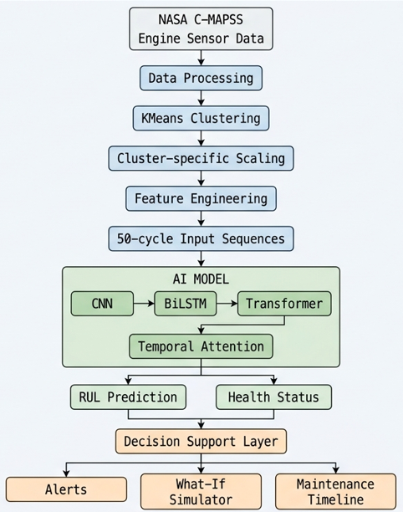
System Architectures
Read-only today — Bob can query the fleet but not yet trigger maintenance actions.
MISSION READINESS COPILOT

Slide 10
TECH STACK
Built end-to-end, live
Languages
Frontend
Backend
Python
JavaScript
React
Vite
D3.js
FastAPI
Machine Learning
AI / IBM
Database & Data
TensorFlow / Keras
Six-model ensemble
Temporal attention
Test-time augmentation
RUL prediction
Confidence estimation
IBM Bob
Model Context Protocol (MCP)
MongoDB Atlas
NASA C-MAPSS dataset
MISSION READINESS COPILOT
10

Slide 11
KNOWN LIMITATIONS
Where the prototype draws the line today
Template-based explanations
Engine-level, not component-level
Readiness explanations are deterministic and template-based today, prioritising reliability and consistency within the hackathon timeframe — not yet LLM-generated.
Predictions are made at the whole-engine level rather than for individual components or subsystems.
Read-only MCP integration
Bob can query live fleet information but cannot yet schedule maintenance, assign technicians, update records, or trigger an overhaul.
MISSION READINESS COPILOT
11

Slide 12
FUTURE SCOPE
Where Mission Readiness Copilot goes next
1
2
3
Continuous model retraining on new operational data
Component-level failure prediction
Real-time sensor streaming
4
5
6
LLM-powered contextual explanations
Predictive maintenance scheduling
Role-based maintenance workflows
7
8
Action-enabled MCP tools
Integration with real-world fleet systems
MISSION READINESS COPILOT
12

Slide 13
TEAM — BOB AND BEYOND
The people behind the Copilot
DP
MM
DB
DA
Dhairyati Pandya
Mitul Mistry
Dhruv Bhagat
Dhvani Ankola
Team Lead
Team Member
Team Member
Team Member
Mission Readiness Copilot · Team Bob and Beyond · AI Track
From sensor data → prediction → readiness → maintenance action — with IBM Bob.
MISSION READINESS COPILOT
13

